Slide 1
Post-processing effects
Advanced Graphics Programming

Slide 2
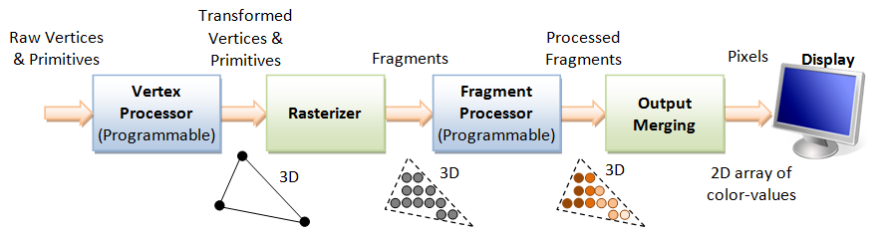
Image synthesis...
Graphics cards
Primary goal: Image synthesis
Input: Geometry, transforms, materials, lights…
Output: Image

Slide 3
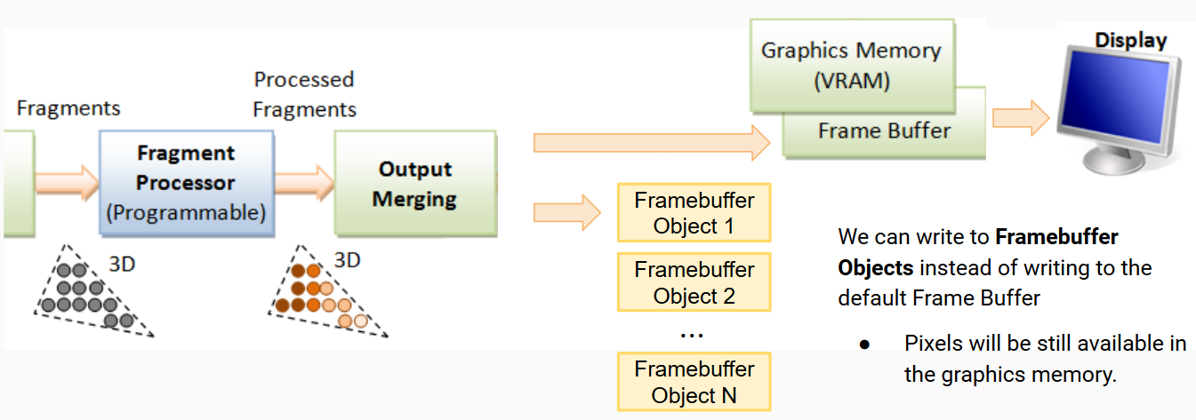
… plus render targets
Graphics cards
Images can be rendered to textures

Slide 4
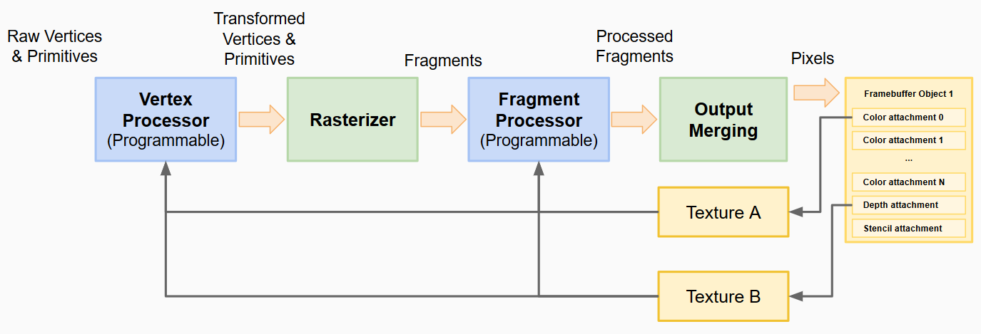
Post-processing effects
Graphics cards
Image synthesis + render to texture post-processing effects

Slide 5
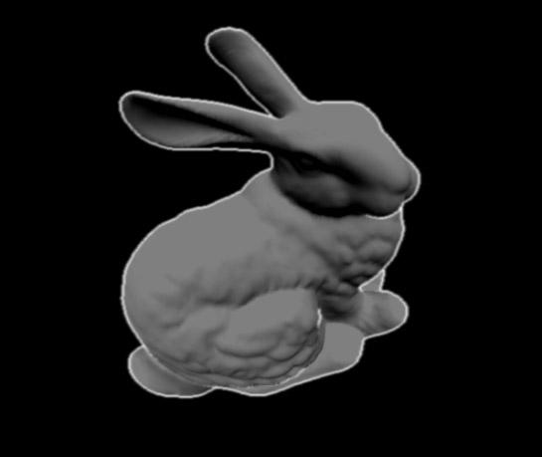
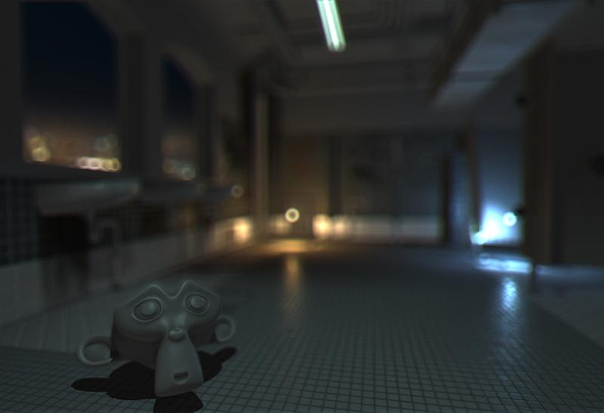
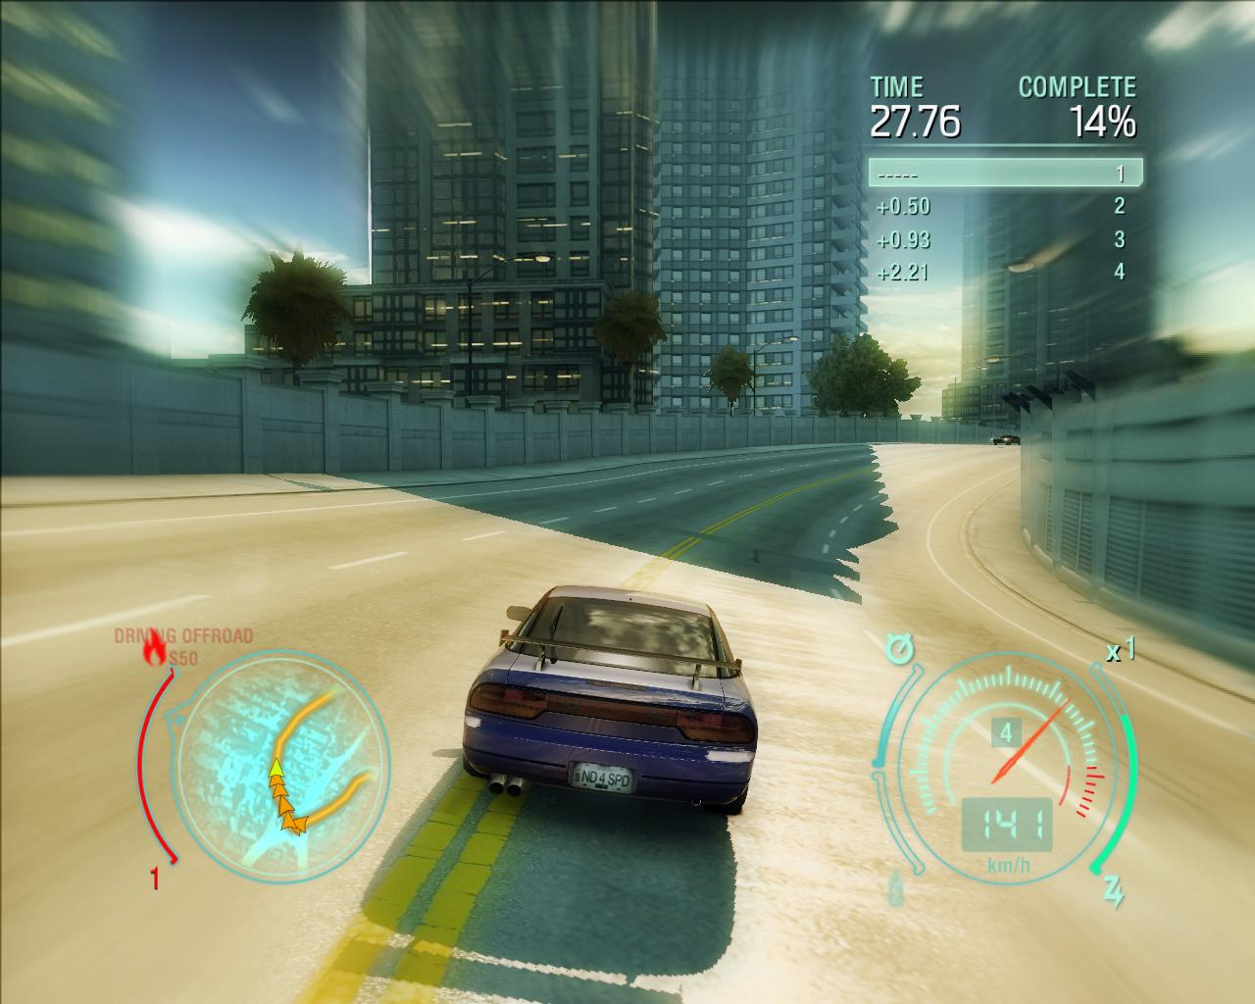
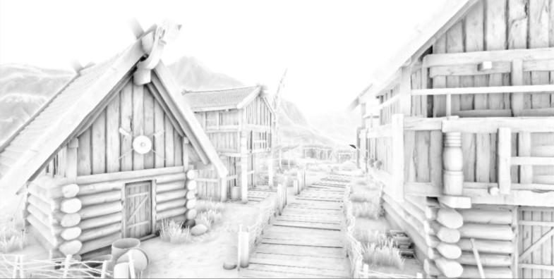
Post-processing effects
Graphics cards
Image processing
Within our game
Edge detection
Blurring
Depth of field
SSAO

Slide 6


General idea
The fragment shader is in charge of processing all the image pixels
Shader program
Framebuffer
Object
Vertex shader
...
pixels
Color attachment
Texture (rendered image)
Fragment shader
Uniforms:
Texture
others...
...
Which fragments?

Slide 7
General idea
Geometry (screen-filling quad)
Shader program
Framebuffer
Object
glDrawArrays
Vertex shader
...
pixels
Color attachment
Texture (rendered image)
Fragment shader
Uniforms:
Texture
others...
...
Rendering a screen-filling quad, fragments are generated populating the whole viewport.

Slide 8
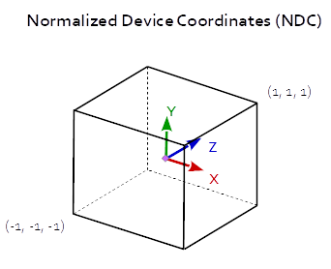
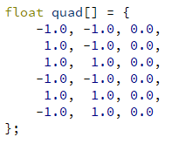
Screen-filling quad
Geometry
(1, 1, 0)
Input Geometry
Screen-filling quad
No transformations
Coordinates already in NDC
If we remember, NDC is almost the final stage of the transformations pipeline. All the geometry within bounds of this cube will be visible (if not culled by other means).
(-1, -1, 0)

Slide 9
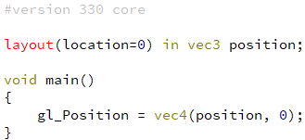
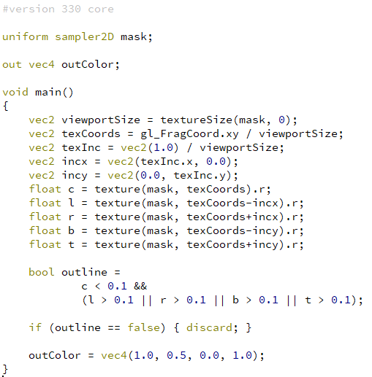
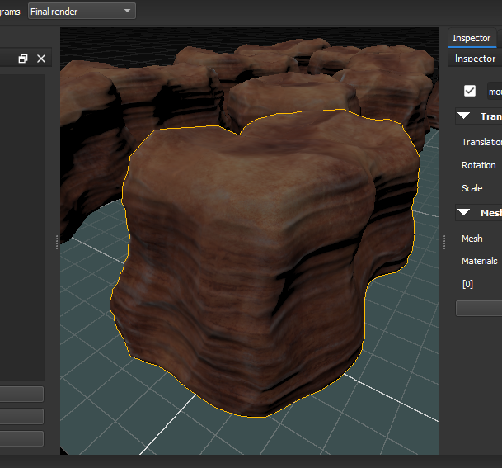
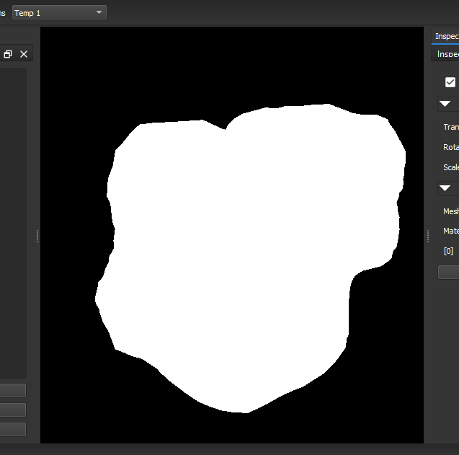
Selection outline
Vertex shader
Fragment shader

Slide 10
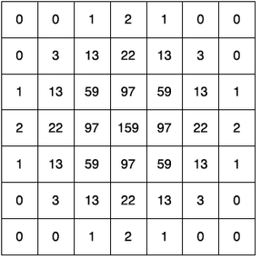
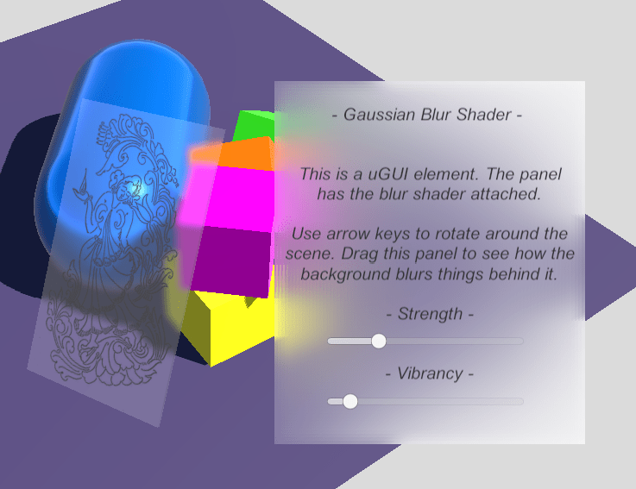
Gaussian blur
2D Gaussian blur
2 nested loops in a shader?
Too expensive
Scales linearly with the size of the kernel

Slide 11
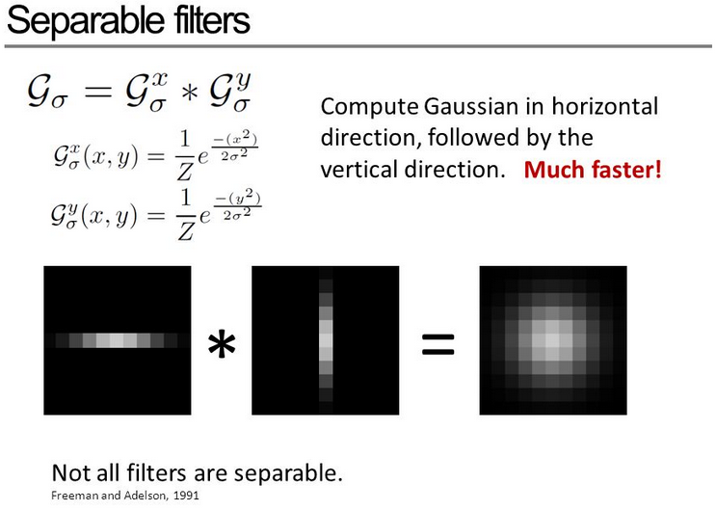
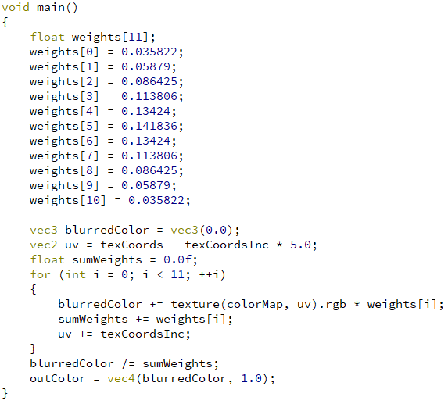
Separable Gaussian blur
2 passes of this shader must be executed
texCoordsInc indicate the 1 pixel increment in horizontal or vertical direction, depending on the pass.

Slide 12
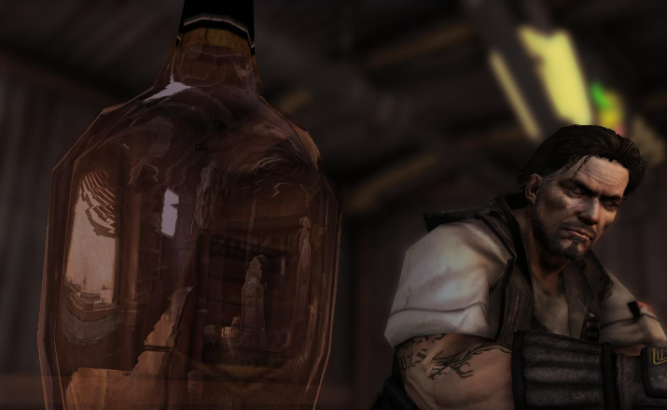
Depth of field
Focused parts sharp
Unfocused parts blurred
Background
Foreground

Slide 13
Depth of field
Focused parts sharp
Unfocused parts blurred
Background
Foreground
Needed input
Color map
Depth map

Slide 14
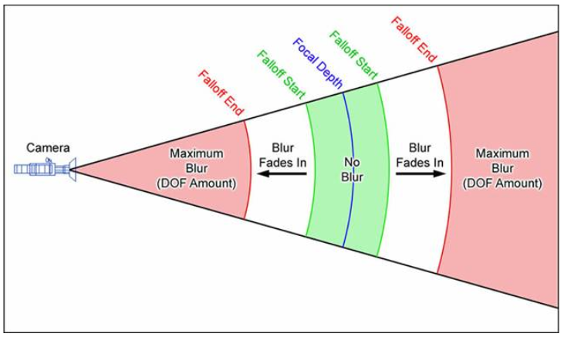
Depth of field
Idea
Selective blur depending on the scene depth.
Focused objects sharp, unfocused objects blurred.

Slide 15
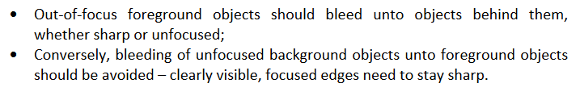
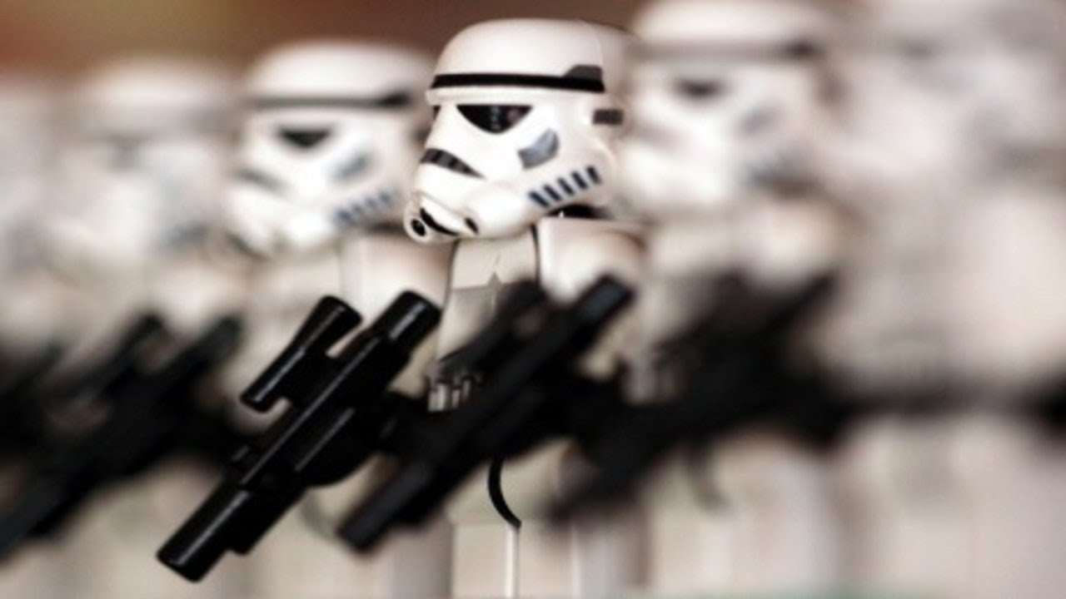
Depth of field

Slide 16
References
Starcraft 2: Effects and techniques: https://developer.amd.com/wordpress/media/2013/01/Chapter05-Filion-StarCraftII.pdf
https://en.wikibooks.org/wiki/OpenGL_Programming/Depth_of_Field

Slide 17

Questions?

